Slide 1
APRENDIZAJE DE MÁQUINAS Data Labellin’ or Data Annotation
John Ballesteros
Profesor Asociado
Departamento de Ingeniería Civil
jballes@unal.edu.co
https://github.com/srobles05/3008422-AprendizajeDeMaquinas

Slide 2
A data – model tandem
Annotated Data
Model

Slide 3
a11X1 + a12X2 +…..+a1nXn = b1
a21X1 + a22X2 +…..+a2nXn = b2
.
.
.
an1X1 + an2X2 +…..+annXn = bn
In a DNN
AX = b, donde: A,X,b son matrices o tensores, A son los parámetros o los pesos, b son los bias (interceptos)

Slide 4
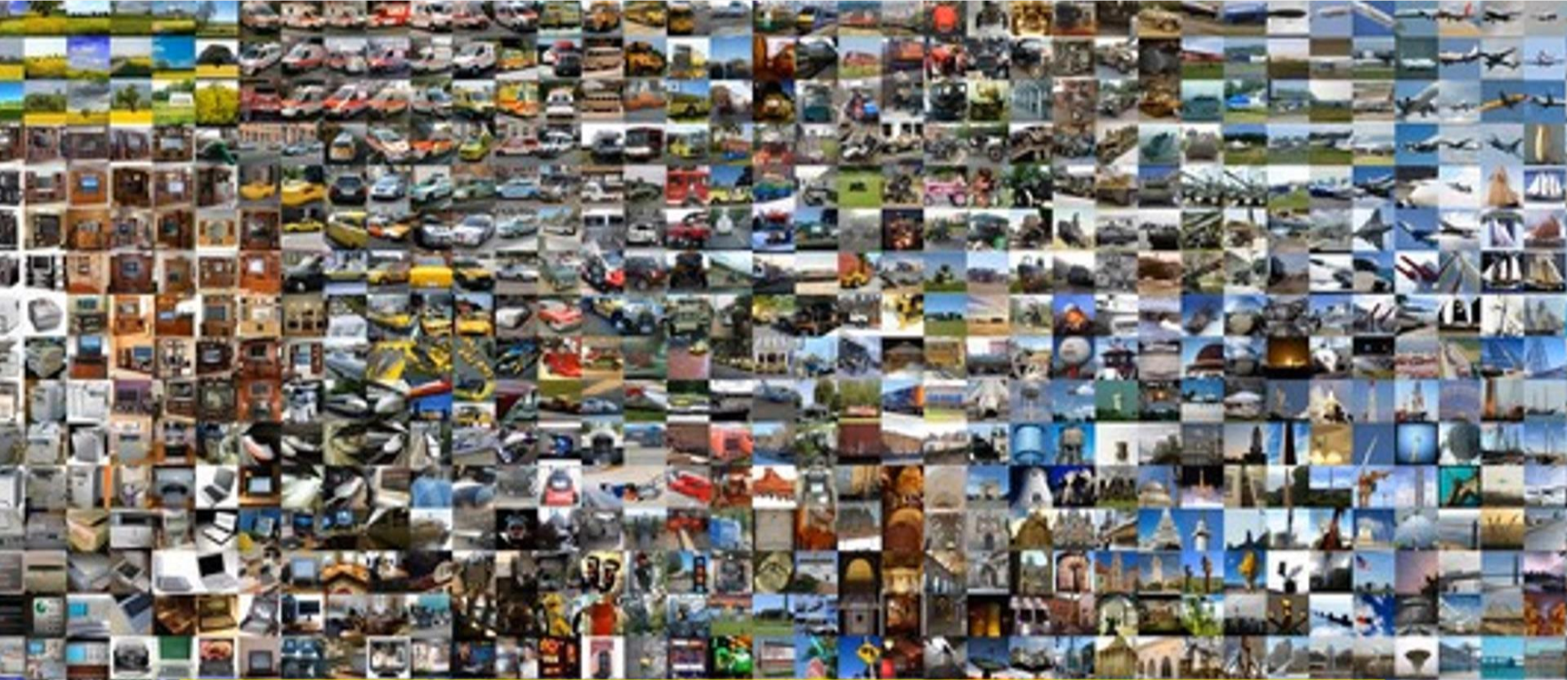
Training Data

Slide 5
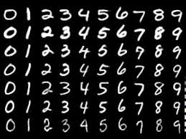
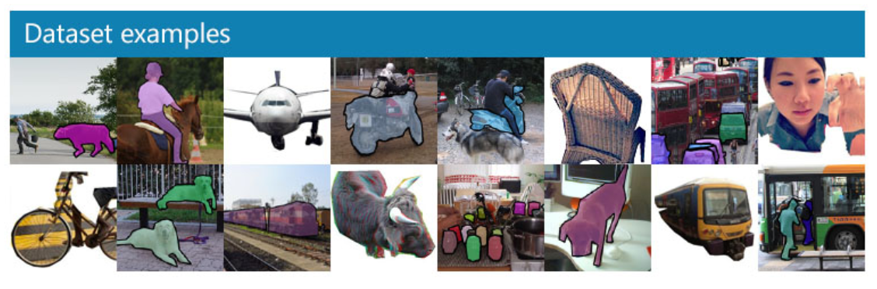
Famous Datasets
Mnist: handwritten numbers (http://yann.lecun.com/exdb/mnist/) Yann LeCun, et all
Coco: common objects in context for detection & segmentation (https://cocodataset.org/#home)
Planet: Multiclassification satellite from amazon rainforest (https://www.kaggle.com/nikitarom/planets-dataset)
Camvid: Segmentation Street datasets (http://mi.eng.cam.ac.uk/research/projects/VideoRec/CamVid/)

Slide 6
Ways to collect data
- From the field (primary)
- From the Internet (secondary)

Slide 7
Different ways of annotate
- In the file name: it’s the most common: ex. dog.jpg, horse.jpg, cat.jpg
- In a separate file: tipically in a .csv file
In a field of a table: target
In the whole image itself: segmentation

Slide 8
Search and scroll Google Images
Be specific, less manual pruning you will have to do.
The maximum number of images Google Images shows is 700.
Put things you want to exclude into the search query using (-)
Limit your results to show only photos by clicking on Tools and selecting Photos from the Type dropdown.
ctrl+shift+j

Slide 9
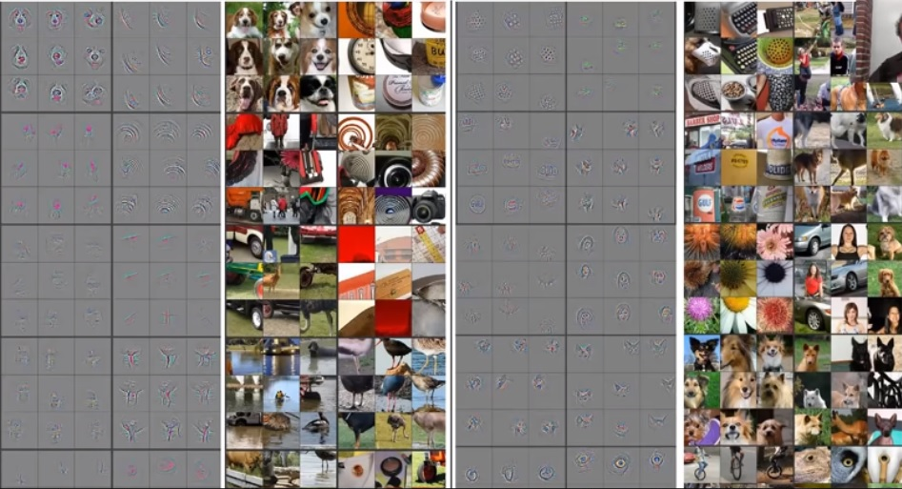
Transfer Learning
learn = create_cnn(data, models.resnet34, metrics=error_rate)

Slide 10
What is enough data?
If hyper parameters: architecture, epochs and learning rate are ok but model accuracy is still not good, below 80%
You need more data !!!!
How to get more data?

Slide 11
Data Augmentation and sintetic data
Programming is the solution, there is little workaround
Python is more than ok: PIL, CV2, and imageo modules do the trick!
Typical transformations are: rotate=flip, scale (affine), warping
This can multiply actual data by 4 !
- Crappify and blurring is easy.

Slide 12
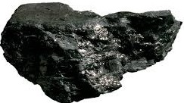
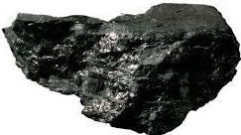
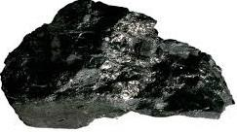
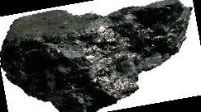
Data Augmentation = Image Transformations (Geometric, Color, etc)
Original
Rotated
Flip
Warped
i = Image.open(os.path.join(mypath, f))
print(f, i.size, i.mode)
i10 = i.rotate(10)
i10.save(os.path.join(mypath,'rot10{}.jpg'.format(fname)))
iflip = i.transpose(Image.FLIP_LEFT_RIGHT)
iflip.save(os.path.join(mypath,'flip{}.jpg'.format(fname)))
ifvert = i.transpose(Image.FLIP_TOP_BOTTOM)
ifvert.save(os.path.join(mypath,'fvert{}.jpg'.format(fname)))
iwarp = i.transform((new_width, height), (Image.AFFINE),(1, m, -xshift if m > 0 else 0, 0, 1, 0),
(Image.BICUBIC))

Slide 13
Examples of problems that can be solved
Binary classification: Damaged/No Damaged--------Prob 1/0 (CNN), Simple Label
Multi classification: Rock classification, Minerals, vipers, trees, outcrops, house assessment--------Prob Treshold above 0.6 (CNN), Multi Label
Image detection: Bounding boxes with probability
Segmentation: each pixel is assigned a value into a category (CNN encoding-decoding), Masks (1 color per class)
Image Generation: Cuttoff, marks & stinks, colorization, improve resolution (more advanced), Neural Style Transfer: GANs

Slide 14
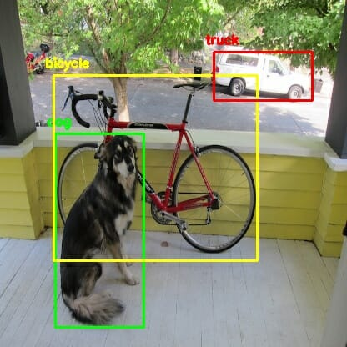
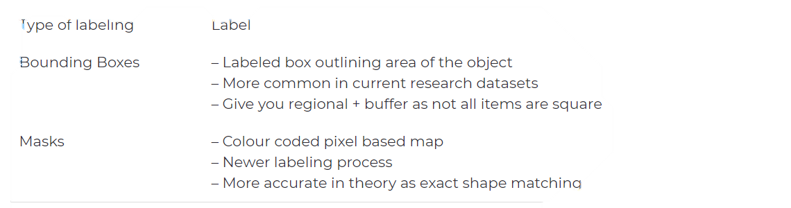
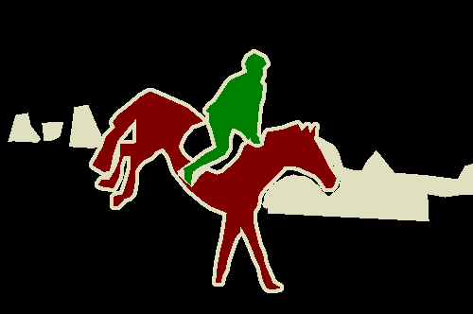
Different problems different types of datasets

Slide 15
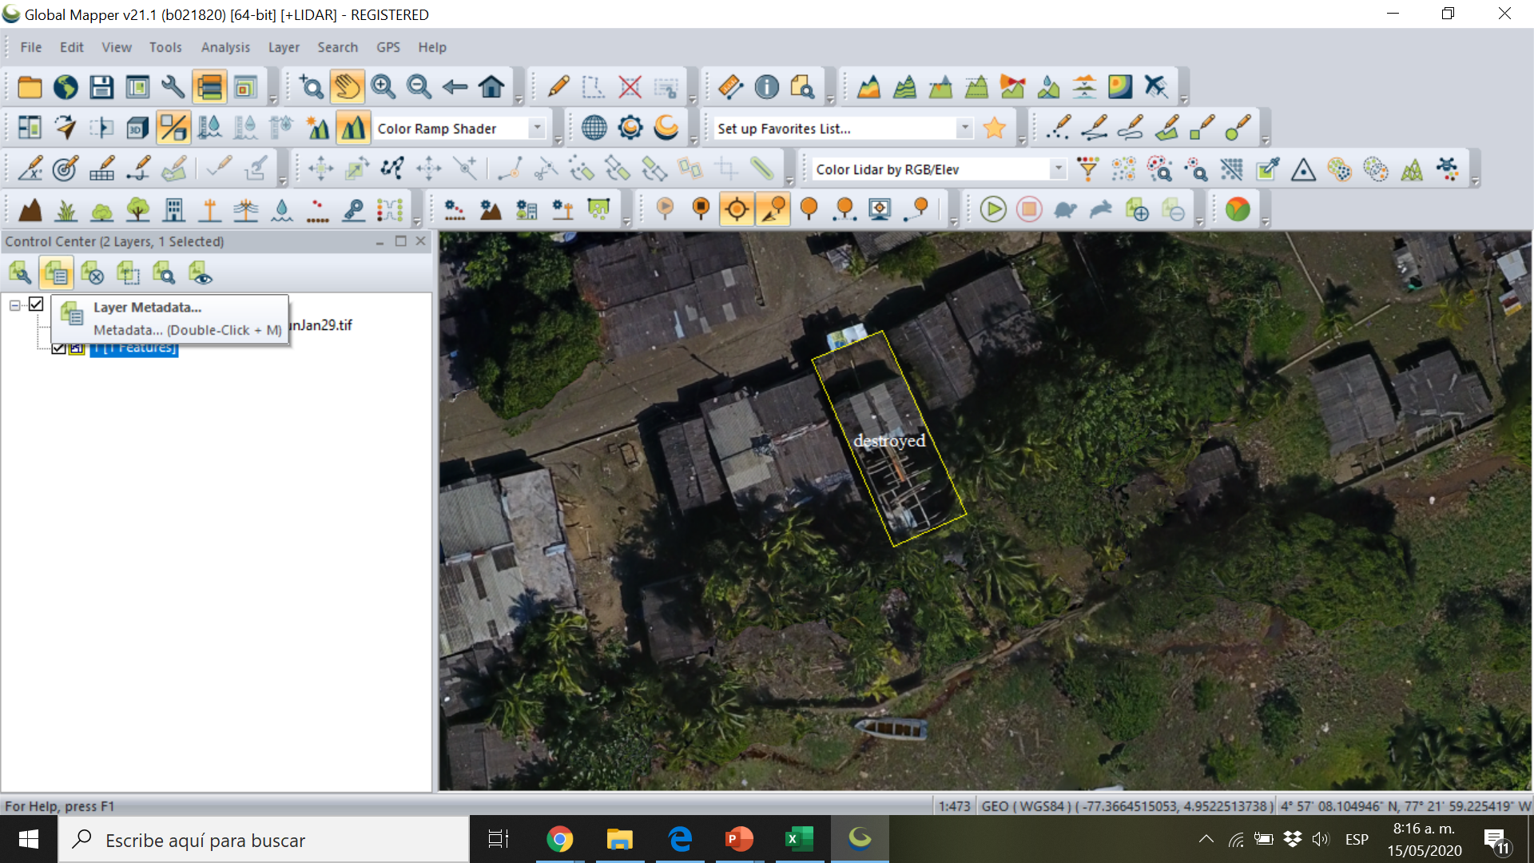
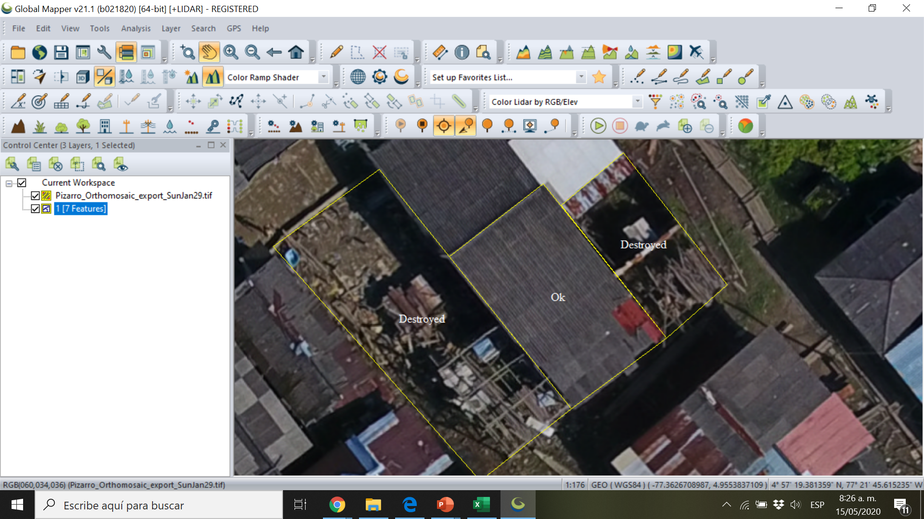
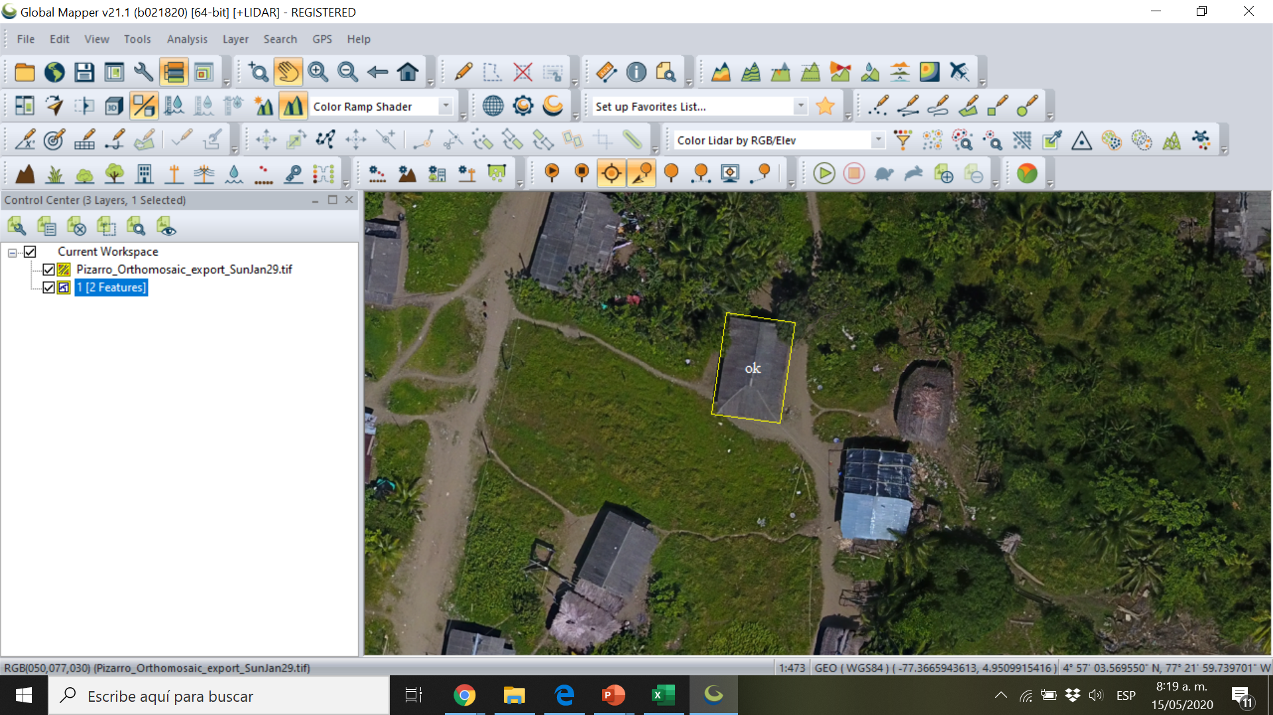
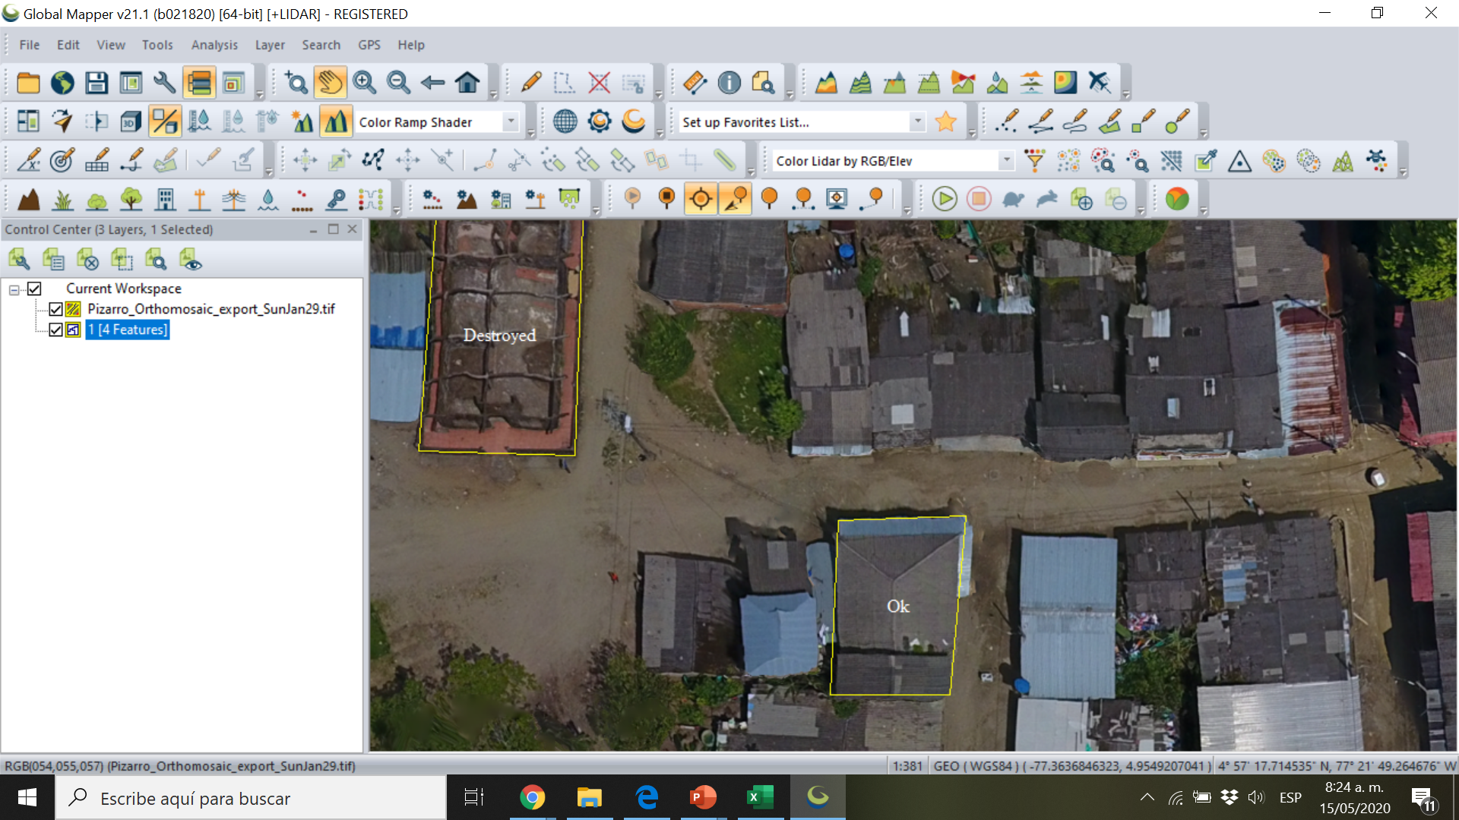

Slide 16
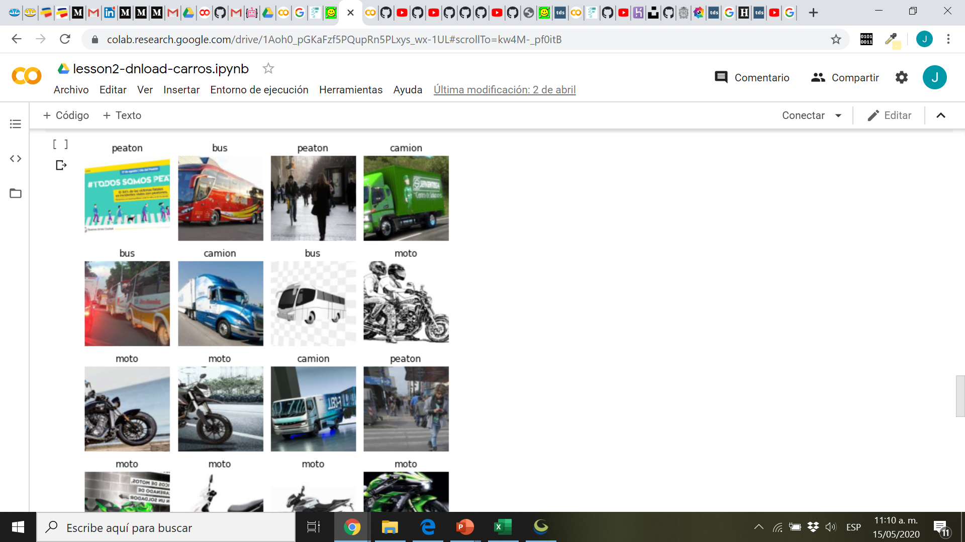
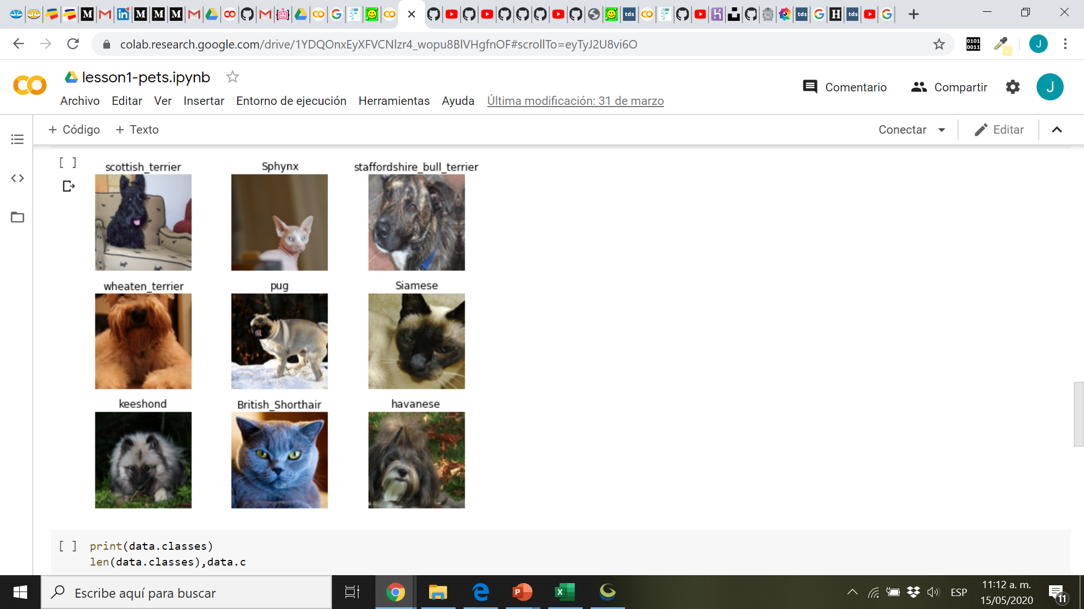
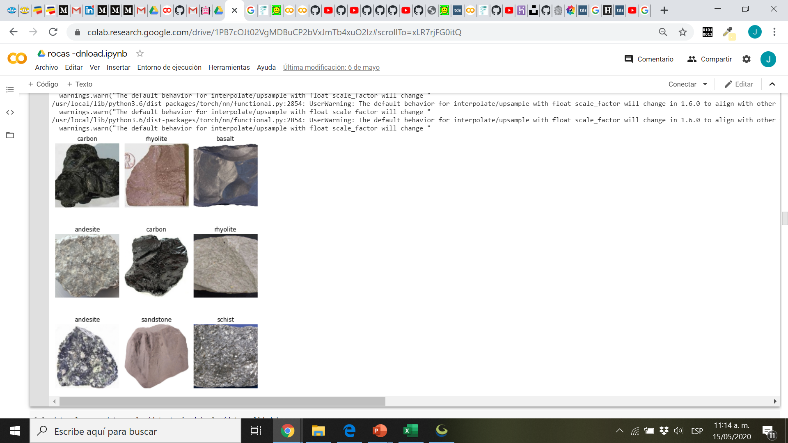

Slide 17
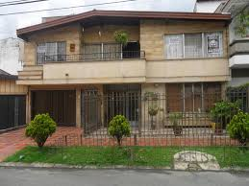
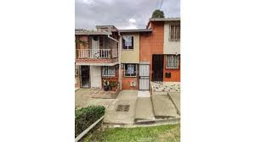
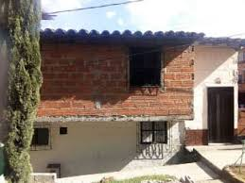
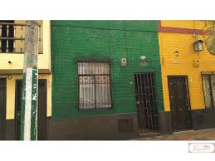
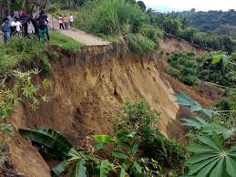
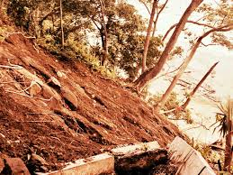
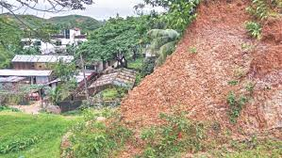
con acabados, garaje, ante jardín, varios pisos, grande, alto valor
con acabados, no garaje, no ante jardín, varios pisos, pequeña, medio valor
sin acabados, no garaje, no ante jardín, varios pisos, mediana, bajo valor
con acabados, no garaje, no ante jardín, 1 piso, pequeña, bajo valor
alta pendiente, no cobertura, alto peso, muy alto riesgo
alta pendiente, no cobertura, alto peso, muy alto riesgo
alta pendiente, no cobertura, bajo peso, muy bajo riesgo

Slide 18
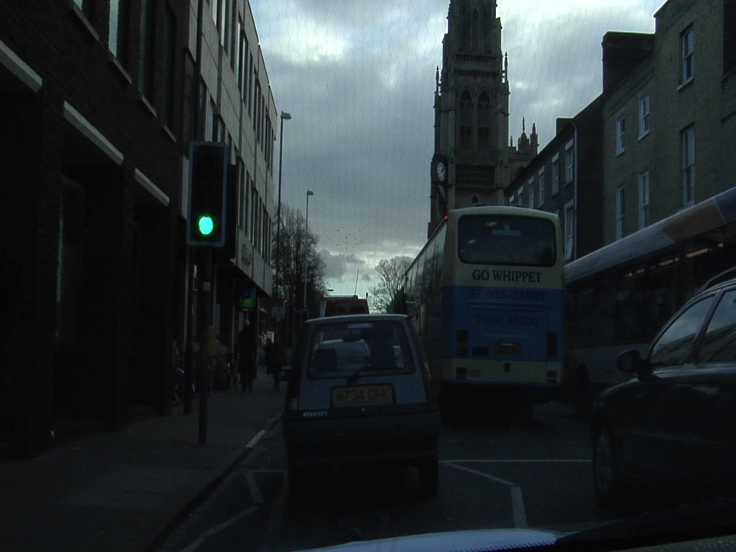
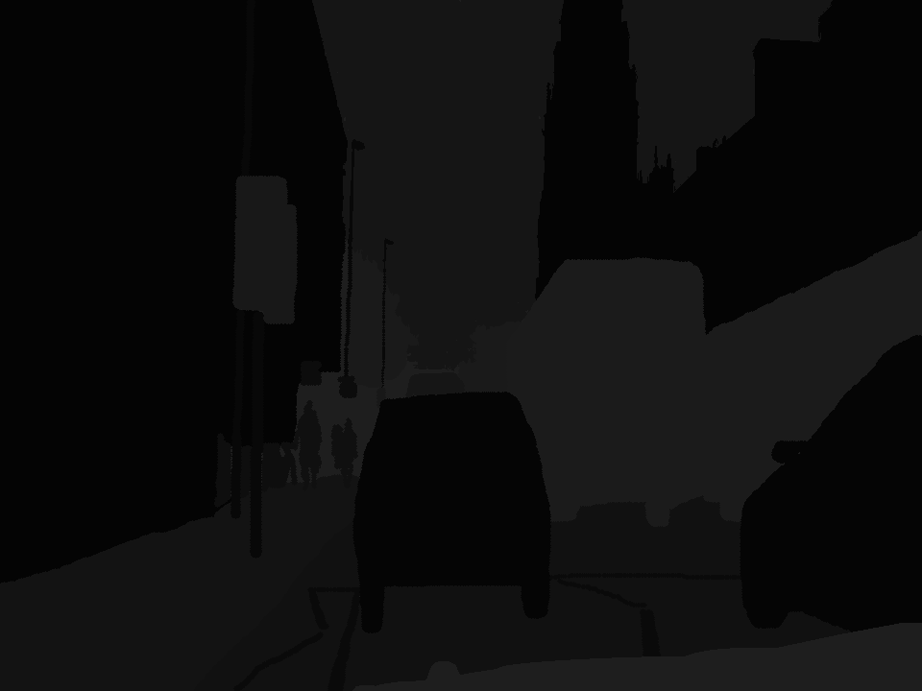
Camvid: Streets Segmentation Dataset

Slide 19
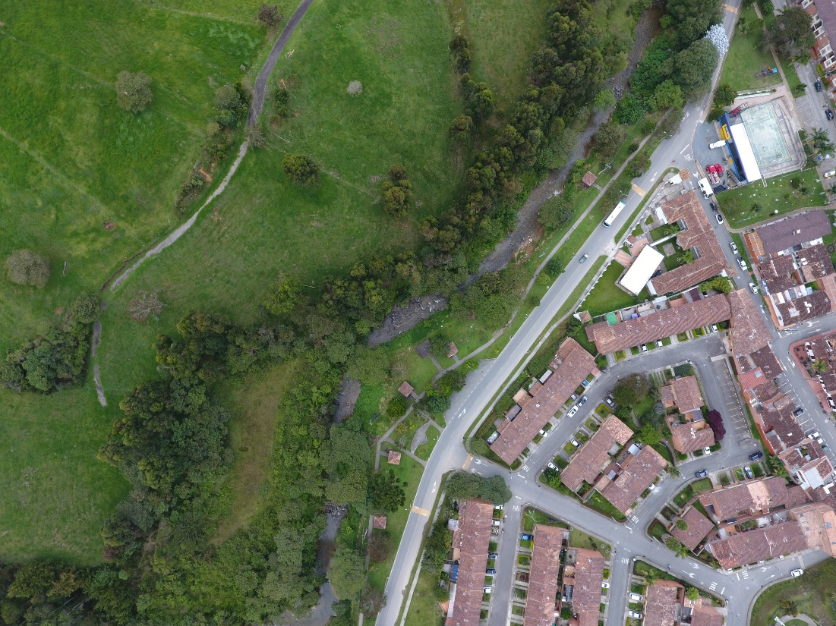
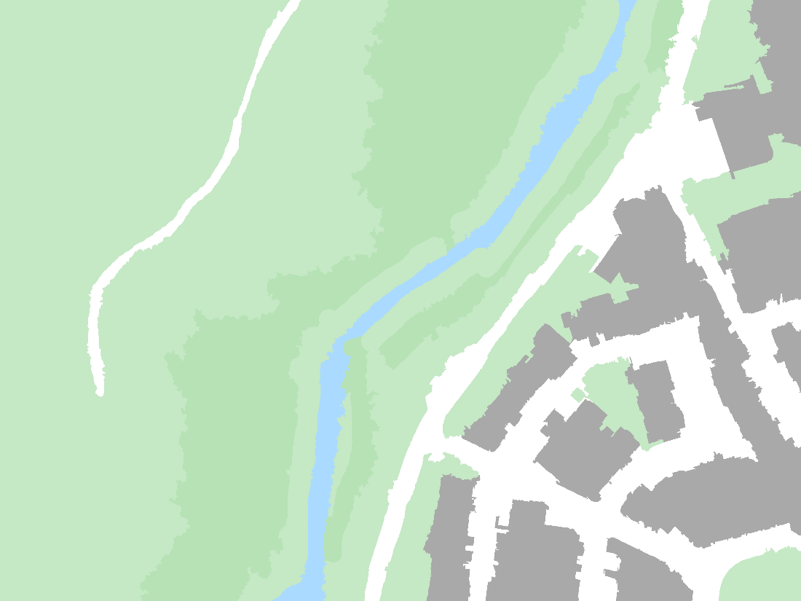
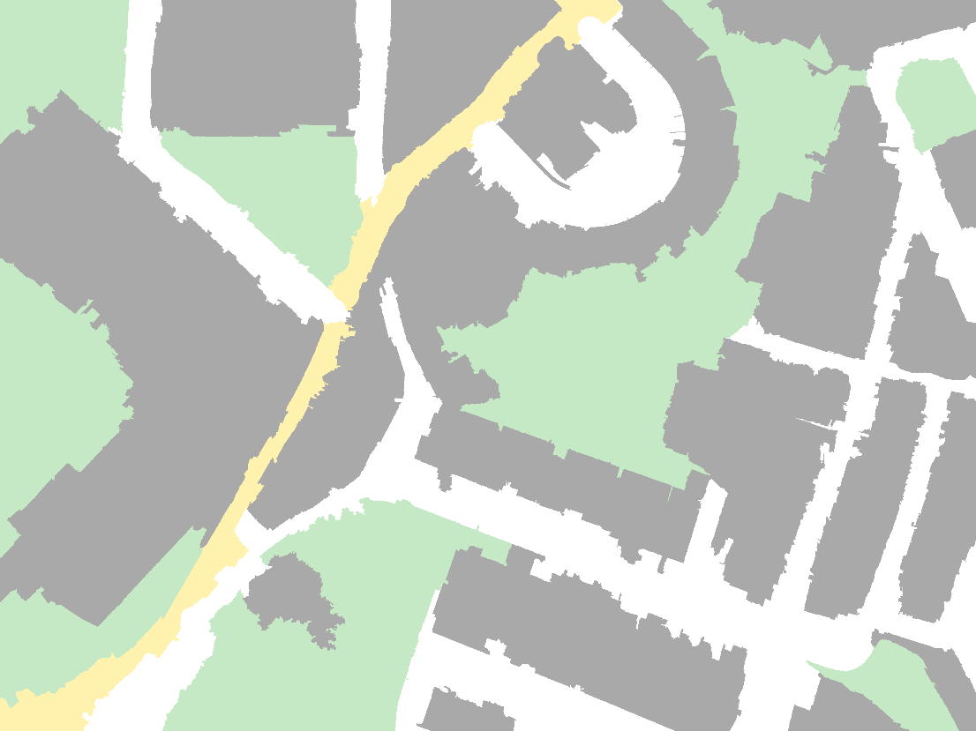
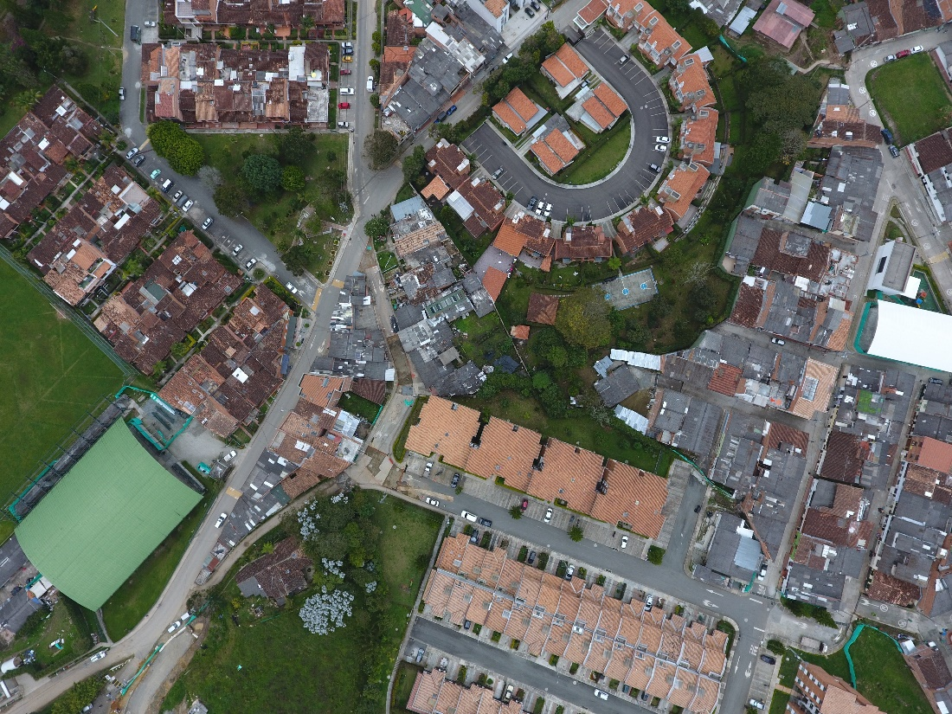
Landcover Segmentation Dataset

Slide 20
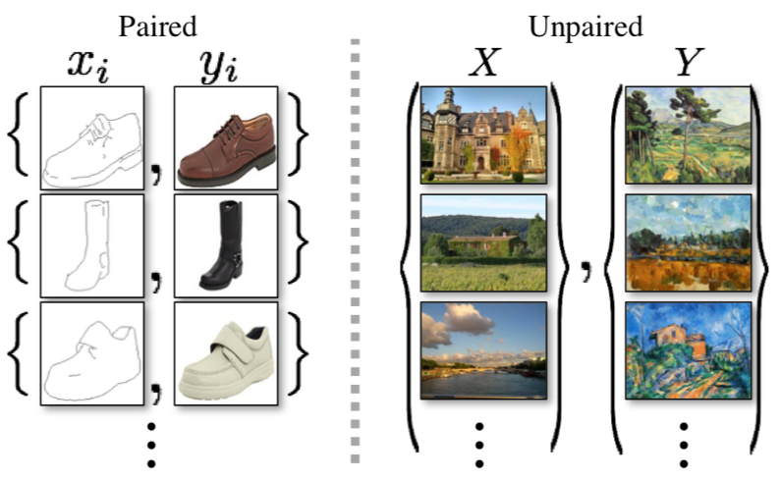
Types of training datasets for image generation
Unpaired Image-to-Image Translation using Cycle-Consistent Adversarial Networks Jun-Yan Zhu*, Taesung Park*, Phillip Isola, Alexei A. Efros Berkeley AI Research Lab, UC Berkeley In ICCV 2017. (* equal contributions)

Slide 21
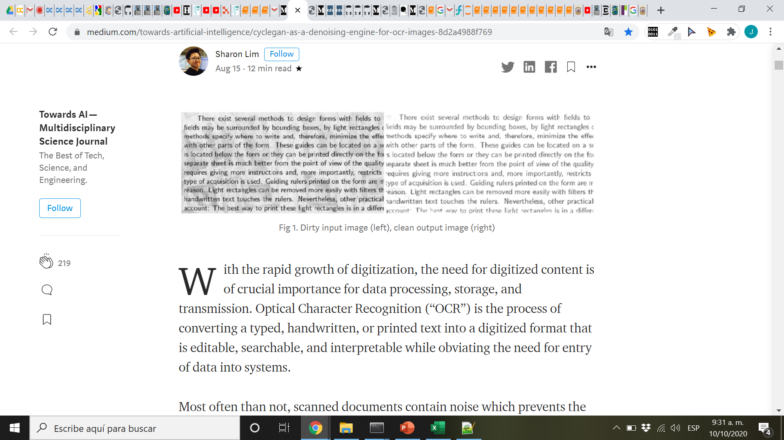
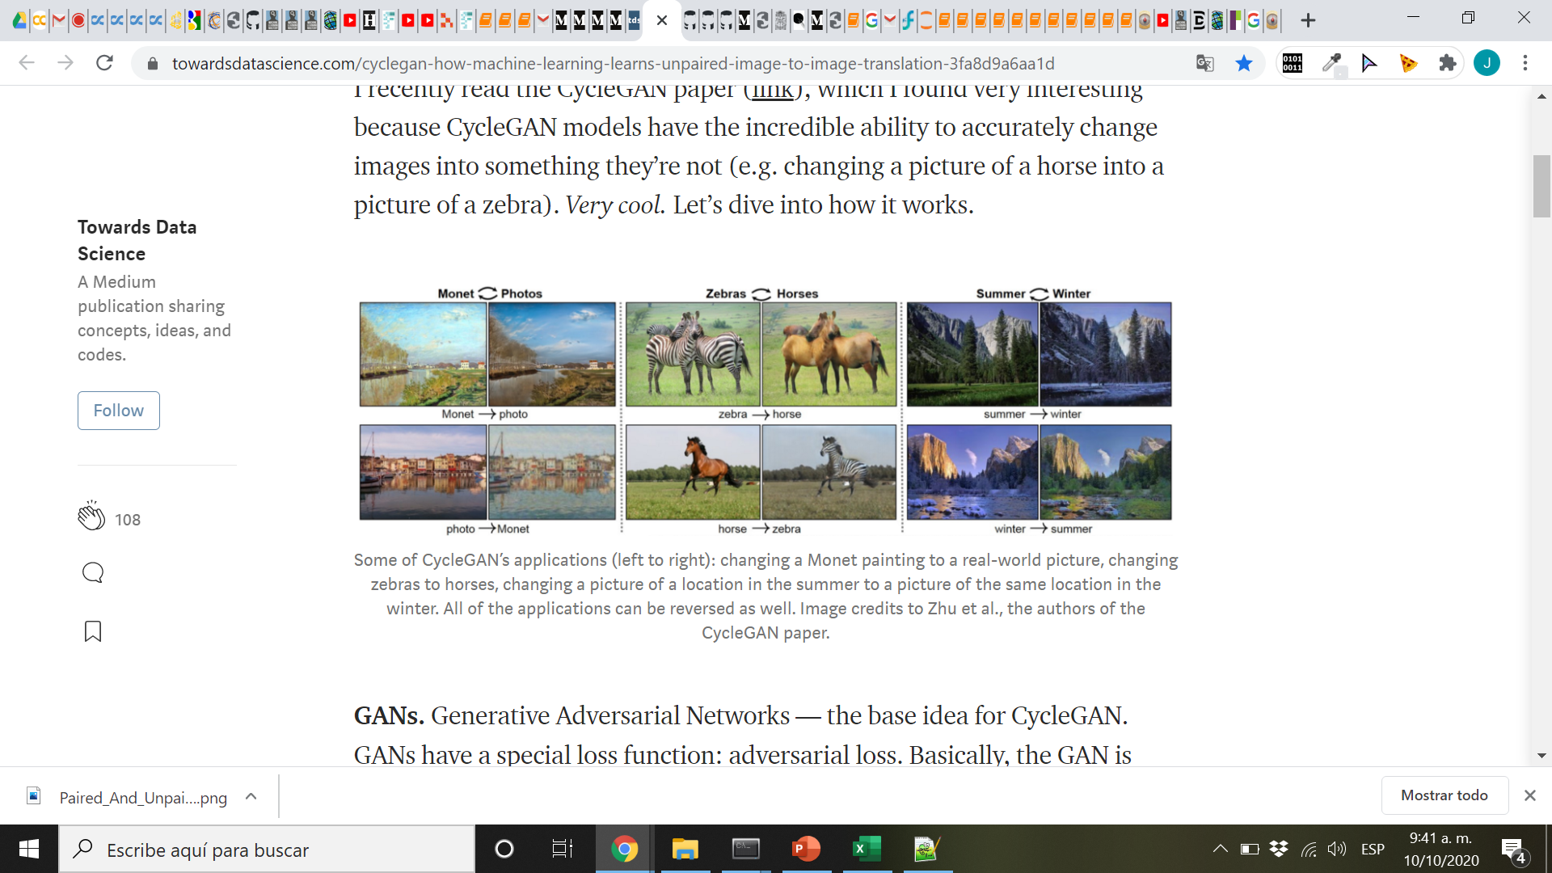
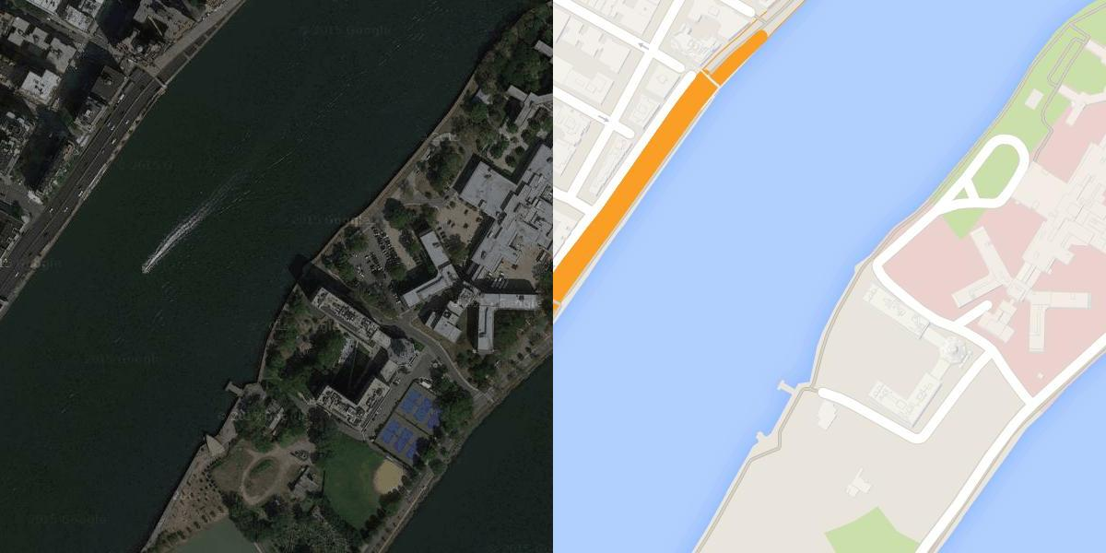
Image Translation: Cuttoff-marks & stinks, colorization, improve resolution, NST (neural style transfer)
Pix to pix
Supervised Learning !
Easy to learn and train, difficult to get data
Pix to pix image translation, Phillip Isola et al In ICCV 2017.

Slide 22
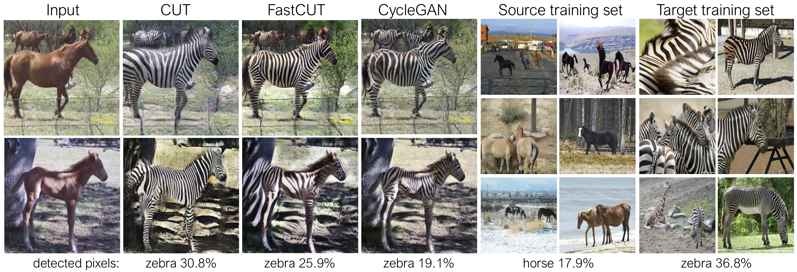
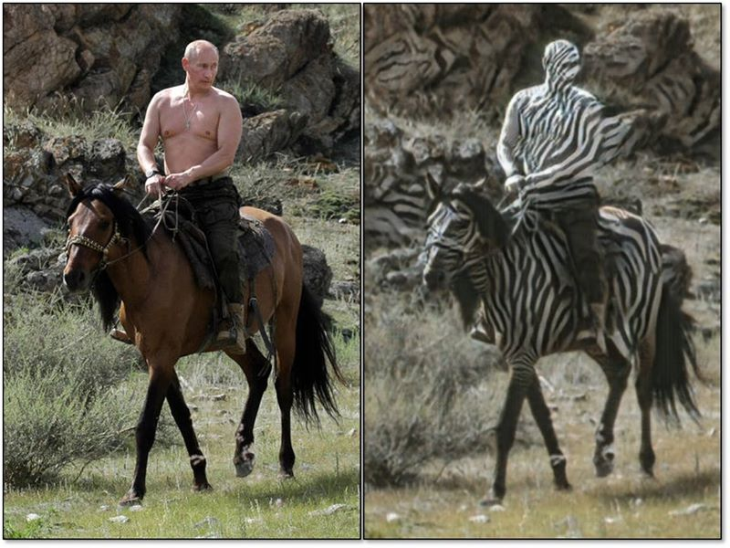
Object transfiguration
Unsupervised Learning !
Difficult to train and learn but easy to get training data
Unpaired Image-to-Image Translation using Cycle-Consistent Adversarial Networks Jun-Yan Zhu*, Taesung Park*, Phillip Isola, Alexei A. Efros Berkeley AI Research Lab, UC Berkeley In ICCV 2017. (* equal contributions)

Slide 23
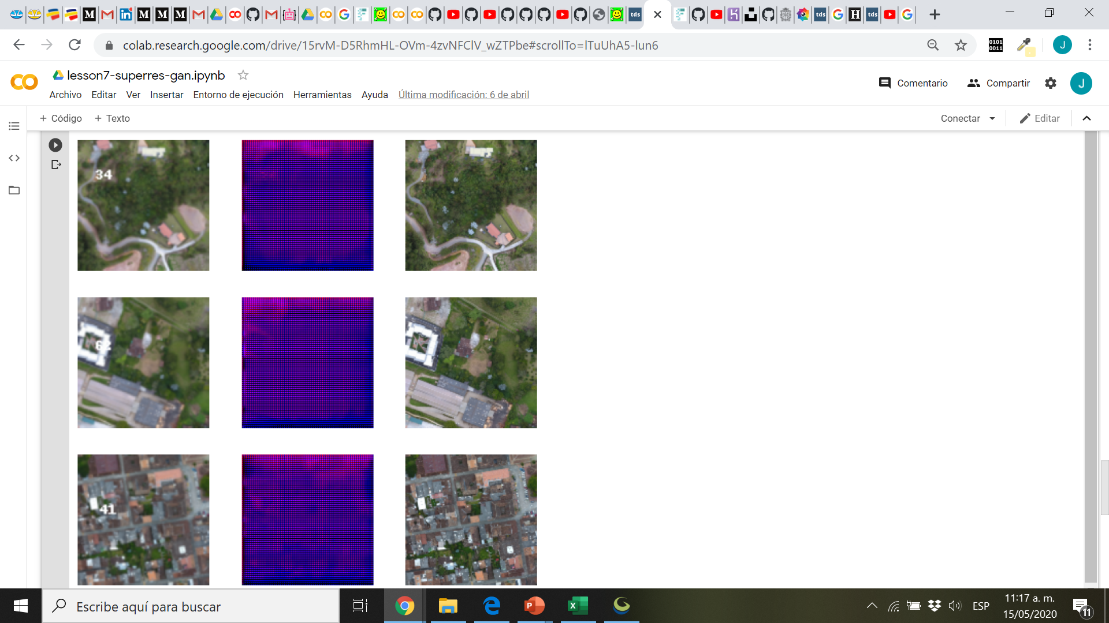

Slide 24
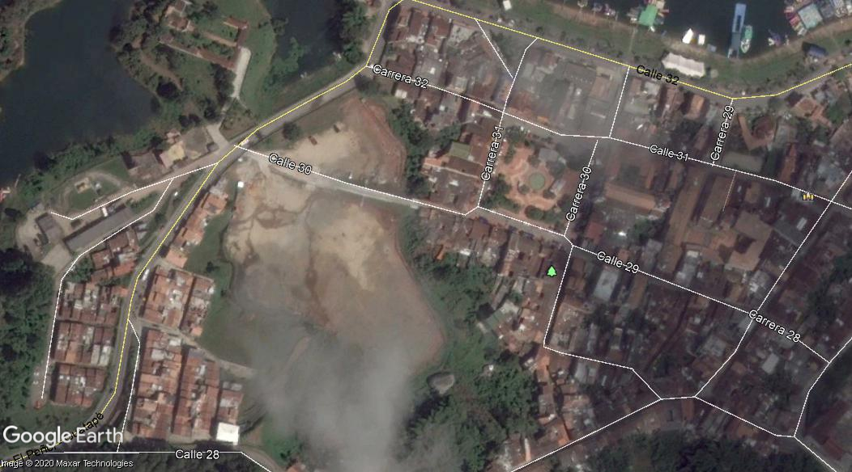
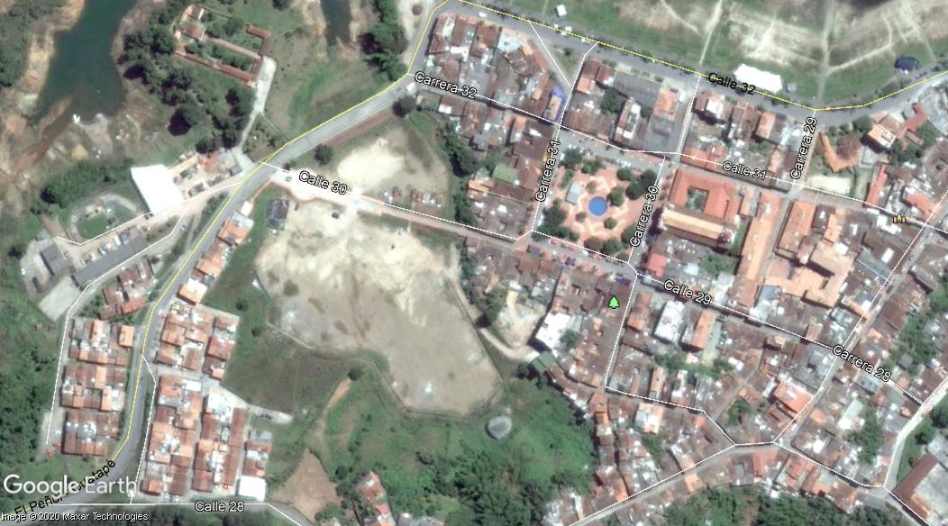
Labelling Time (research topic)

Slide 25
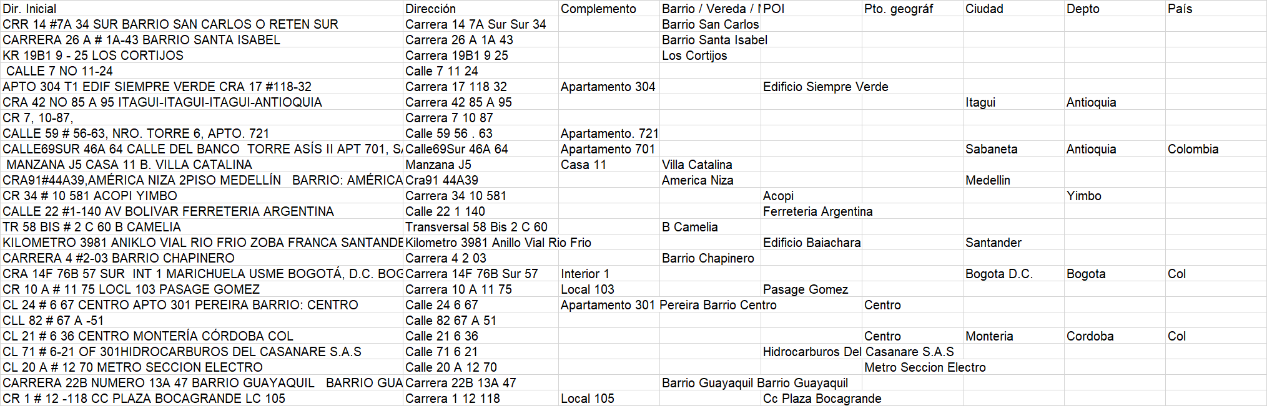
What about data in text and tables?

Slide 26
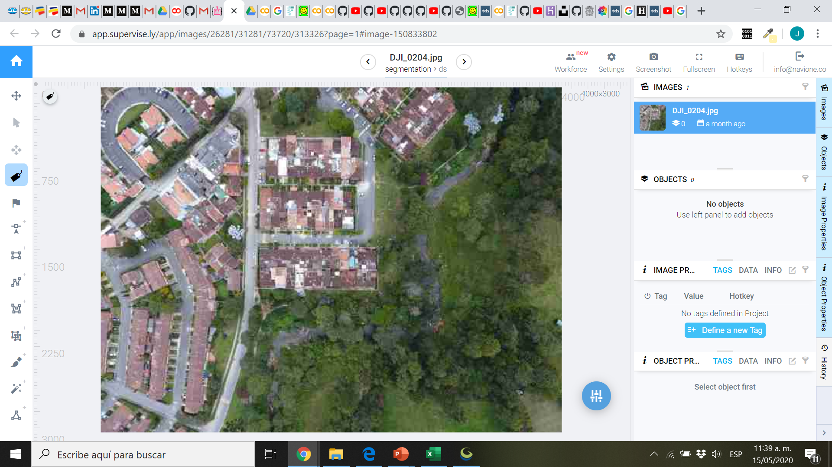
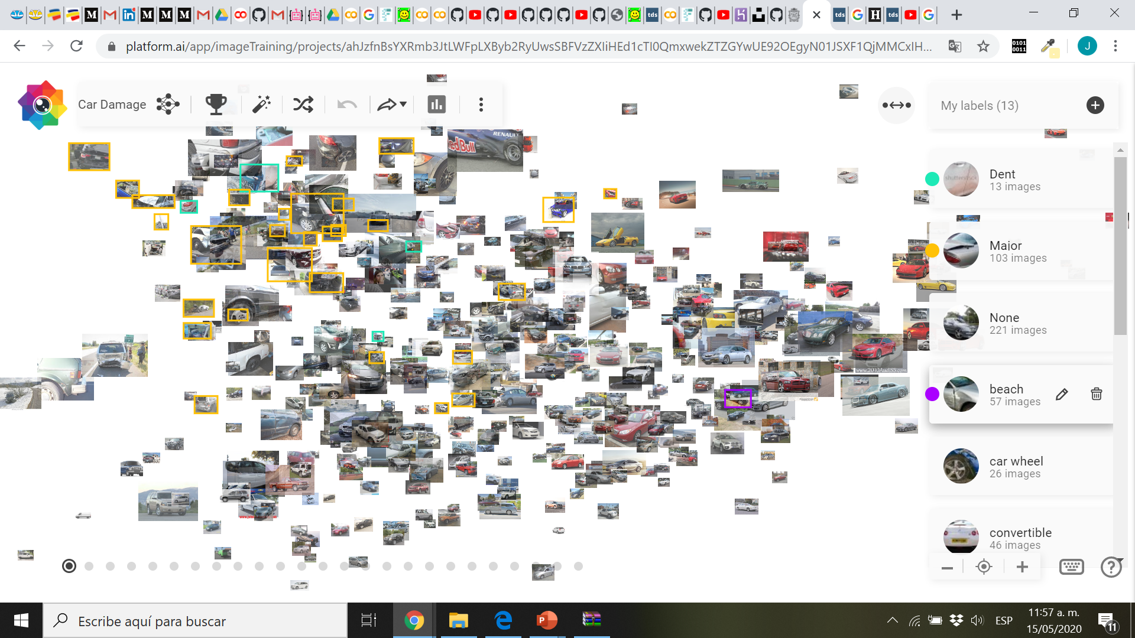
Software for Labelling
Supervisely: www.app.supervise.ly
Platform.ai: www.platform.ai
PixelAnnotationTool (github)

Slide 27
Working Examples
multilabel.herokuapp.com

